Slide 1
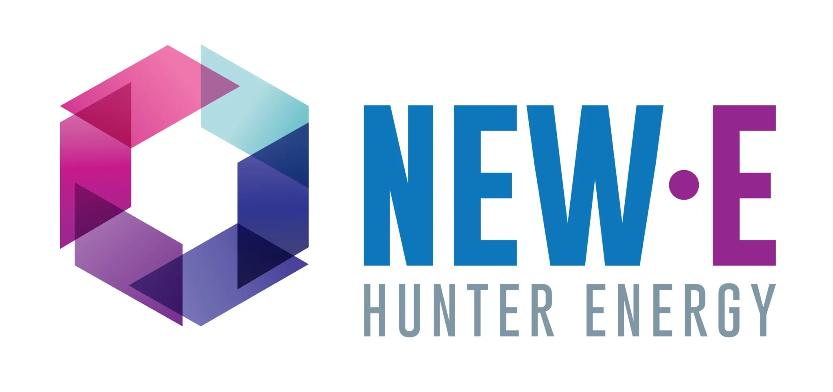

Project Overview
Project Name
Project Location
Hunter-Central Coast Renewable Energy Zone
Muswellbrook
Proponent
Lead Contractor(s)
EnergyCO
John Holland
Project Type
Estimated Project Value
Substations
Under $100 Million
Current Project Stage
Anticipated Construction Start
Construction – Earth works
Q1 - 2026
Project Description (2–3 sentences)
We came together with our partners Ausgrid and EnergyCo to deliver two new greenfield substations at Muswellbrook and upgrading existing distribution infrastructure to support future renewable energy generation and enable up to one gigawatt of clean, affordable energy to be supplied into the NSW grid.
The Hunter-Central Coast REZ is the first renewable energy zone in Australia to upgrade existing distribution poles and wires, helping minimise impacts on the community and the environment.
This project brief has been prepared solely for the Supply Chain Connect forum facilitated by New.E, EnergyCo and HunterNet. It does not constitute a procurement commitment or guarantee of future work.

